Slide 2
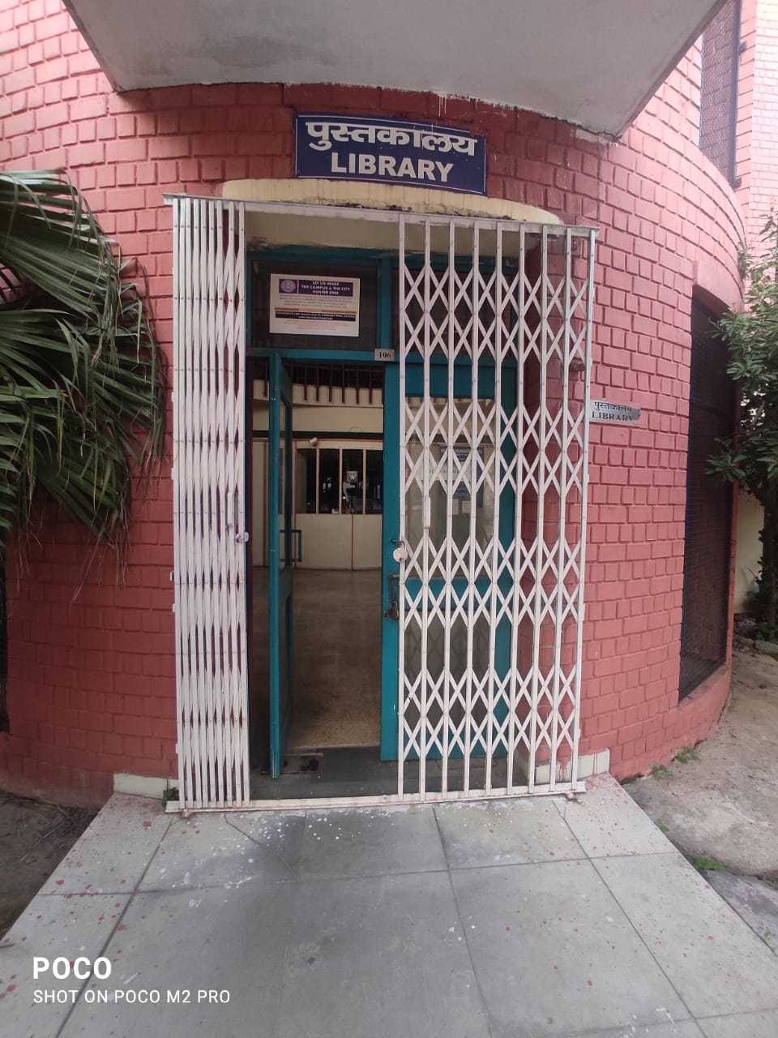
USER
AWARENESS
PROGRAM
Notes:
PPT FOR :-
LIBRARY USER
AWARENESS

Slide 3
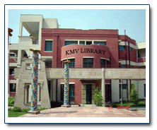
KESHAV MAHAVIDYALAYA LIBRARY

Slide 4
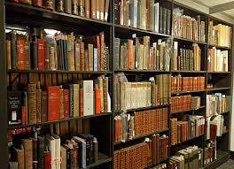
ABOUT THE LIBRARY
Keshav Mahavidyalaya Library is a Duplex library. It is well stocked, well furnished library. It is a spacious library comprising of a big air-conditioned Reading-Room common for all users at Ground floor.
The Library has more than 28800 Books. (It has a good collection of Text Books as well as Reference Books)
The library has a separate Internet Lab for Students and Faculty with internet facility provided by University of Delhi. Users can access various E-resources there under our supervision.
Working Hours :- 9:00 A.M. to 5:30 P.M. on all working days including Vacations (summer and winter vacations) except official holidays of Delhi University.
It is a Web Based Library. The Library’s Data is on NIC cloud through e-Granthalaya software.
KMV Library has a Membership of N - list also
Notes:
Keshav Mahavidyalaya College Library is a Duplex library. It is well stocked, well furnished library. It is a spacious library comprising of a big air-conditioned Reading-Room common for all users at Ground floor.
The Library has more than 28800 Books. (It has a good collection of Text Books as well as Reference Books) .The library has a separate Internet Lab for Students and Faculty with internet facility provided by University of Delhi. Users can access various E-resources there under our supervision.
working Hours :- 9:00 A.M. to 5:30 P.M. on all working days including Vacations (summer and winter vacations) except official holidays of Delhi University.
It is a Web Based Library. The Library’s Data is on nic cloud through e Granthalaya software.
Library has a Membership of N - list also

Slide 5
Library Membership
Students need to furnish their fee receipt and college identity card to become a member.
Library Membership Form is to be submitted after admission is secured.
Library Membership is yearly, and clearance needs to be taken at the end of every academic session.
Library Reader Tickets (cards) are non-transferable.

Slide 6
Library Cards
Students are given four (04) Library Reader’s Tickets (Computer Science (H)-05) which can be used at the same time to facilitate readings.
On Library Reader’s Ticket No. 4 book will be issue for one day only and on rest of the Library Reader Tickets books will be issued for fifteen days.
Return Library Books on or before the due date to avoid late fine.

Slide 7
LIBRARY RULES
Students cannot carry any bags into the library.
In case of transfer of library tickets the ticket of the original card holder will be cancelled.
In case of tearing of pages from any book is reported, strict disciplinary action will be taken.
If a Reader/member lost his/her library ticket, a duplicate library ticket will be issued to him/her in the next academic year to avoid any kind of misuse of the library tickets.
Duplicate cards due to repeated loss of Reader’s Tickets shall be considered only after prior approval of the Principal.
Students have to show College I-Card at the entry gate of library and while issuing the library books.
Books on loan can be called at any time without assigning any reason thereof.

Slide 8
COMPUTERISATION OF LIBRARY
In stage one, KMV Library was fully Automated and updated with Libsys Software (L S ease version). AMC of Libsys Software was done on Regular Basis upto 2017.
Then in 2017-18 KMV Library shifted to e-Granthalaya software from Libsys Software. Now it becomes a web Based Library.
Library's data is available on NIC CLOUD.

Slide 9
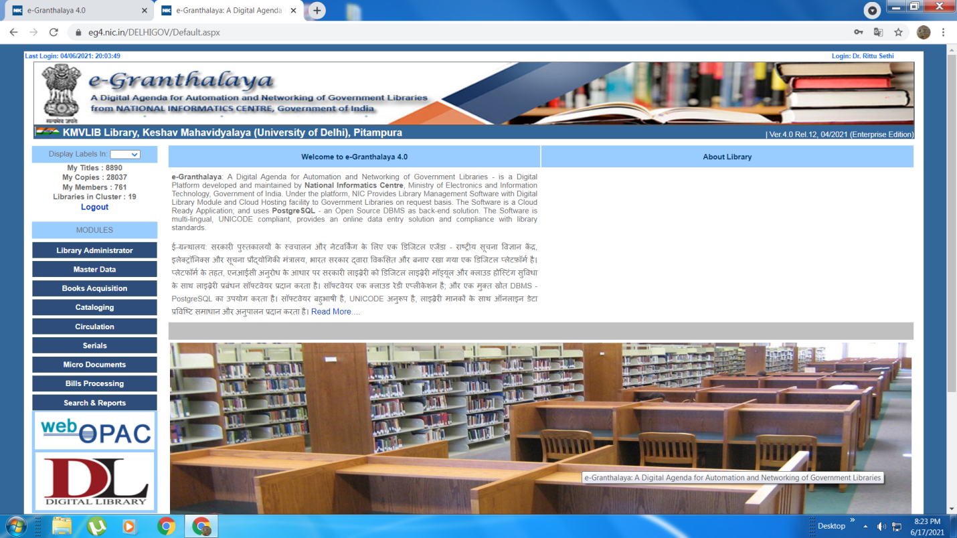
e- GRANTHALAYA

Slide 10
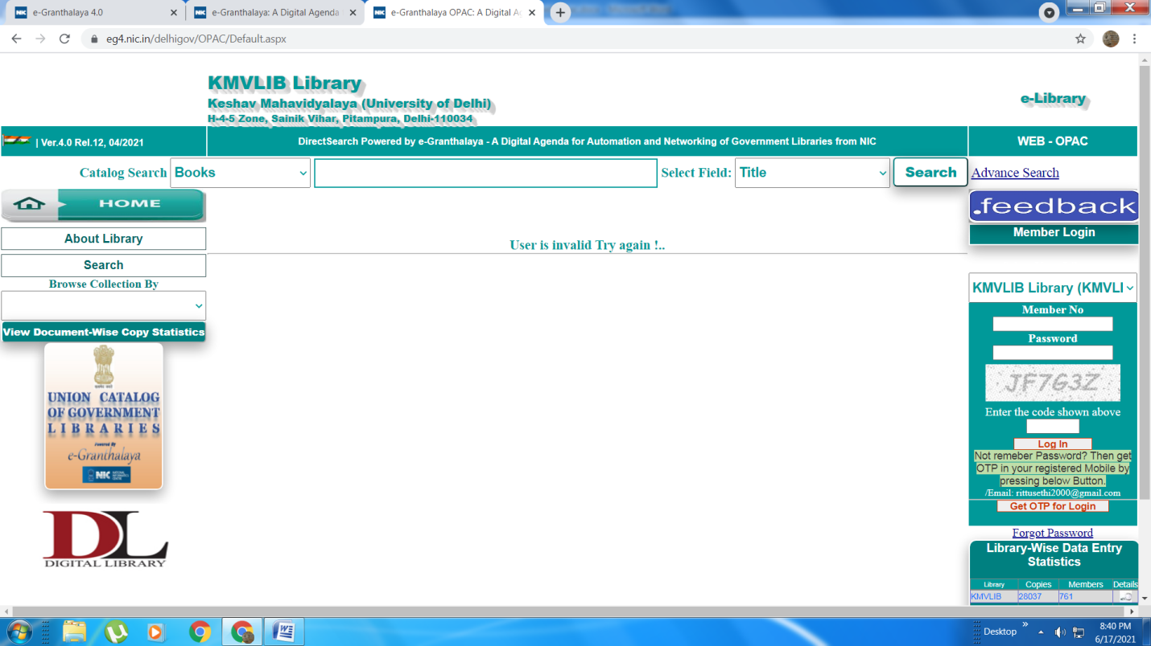
WEB -OPAC
WEB – OPAC KESHAV MAHAVIDYALAYA LIBRARY

Slide 11
Easy Steps Of Using e- Granthalaya 4.0 (Online software) Library Cluster : Delhi Government Libraries Network
LIBCODE: KMVLIB To access e-Granthalaya 4.0 Online Data Entry Interface, please access http://eg4.nic.in, then select your Library Cluster - Delhi Government Libraries Network from drop-Down and press SUBMIT. Click on Web Opac then choose library . Library Code is KMVLIB.
You Can also Access Online Catalog of all the Libraries in your Cluster at : http://eg4.nic.in/DELHIGOV/OPAC/Default.aspx. Besides, Your Own Library OPAC URL will be : http://eg4.nic.in/DELHIGOV/OPAC/Default.aspx?LIB_CODE=KMVLIB
* Plz Read User Manual to use the Applicaiton with full potential.

Slide 12
BOOK - COLLECTION
• The Library has more than 28000 books with new books and editions added every year. It has a very good collection of text books and reference books. All the books and documents are properly Organized.

Slide 13
e - RESOURCES
Library has more than 700 CDs and DVDs .
(These are issued to various departments of the college).
College-Library has the facility to access
e-resources, e-journals provided by Delhi University
Library System through Internet/website.
Approximately 50,000 journals/e-resources are
available on Delhi University website (http:///
SUBS.E-RESOURCEcrl.du.ac.in/sub.database.htm)

Slide 14
PERIODICALS
Large number of dailies, weeklies, periodicals are being subscribed by the library on regular basis. Every year total number of newspapers purchased by the Library are 18 and magazines are 34.
Every year I put a notice for teaching, non-teaching and students to review newspapers and magazines and then put their proposals in Library Committee to review accordingly.

Slide 15
LIBRARY SERVICES
Under my Guidance & Supervision Keshav Mahavidyalaya Library provides Various Services to its users:-
LIBRARY SERVICES
CIRCULATION SERVICE
TECHNICAL SERVICE
WEB OPAC
RESERVATION SERVICE
REFERENCE SERVICE

Slide 16
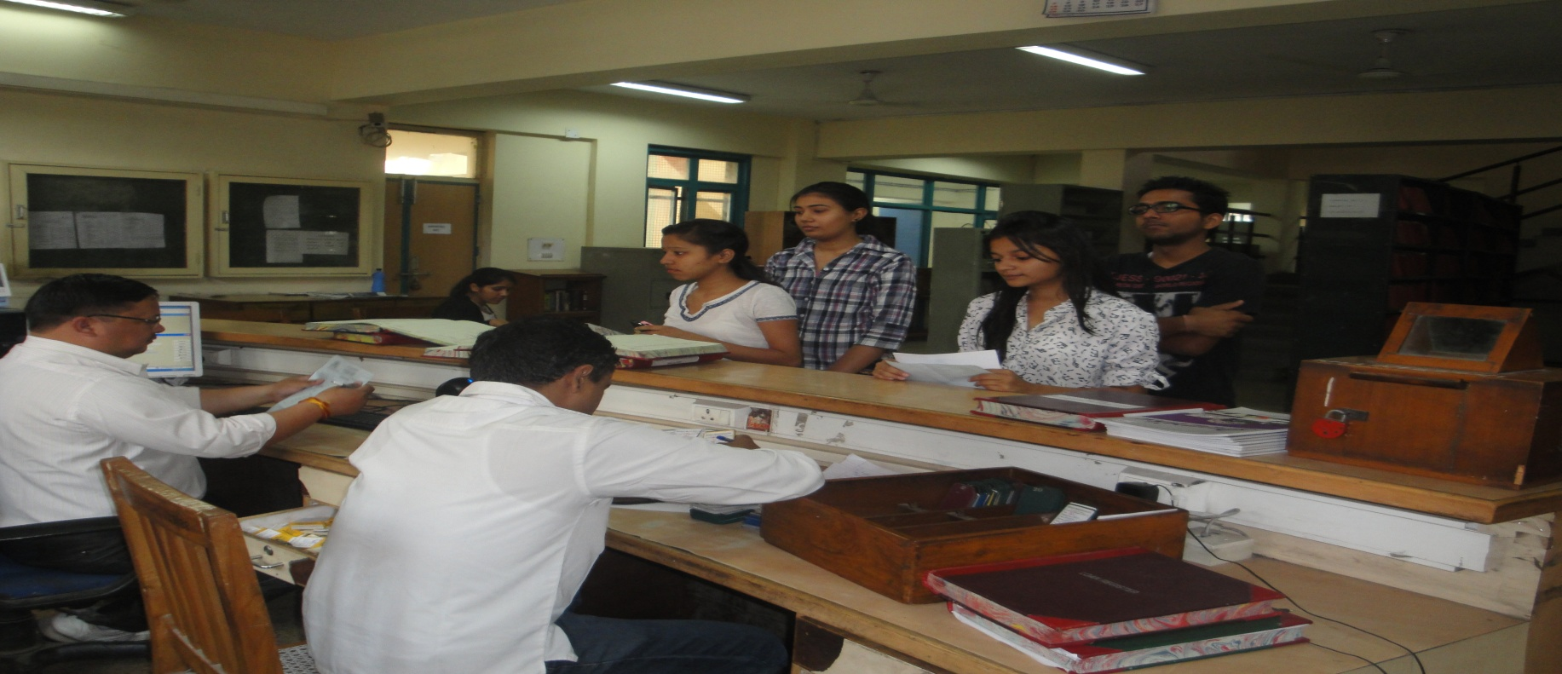
CIRCULATION SERVICE
Circulation Services :- Circulation is one of the key departments of a Keshav Mahavidyalaya library. Text Books are provided on loan for fourteen days and Reference books for one day.

Slide 17
TECHNICAL SERVICE
Technical Services (i.e. Classification and Cataloguing Services) :- Keshav Mahavidyalaya Library follows Dewey Decimal Classification. Library has WEB OPAC.

Slide 18
REFERENCE SERVICE
Reference service is also being provided by Keshav Mahavidyalaya library, so that the users can get the maximum benefit of the available resources of the library.

Slide 19
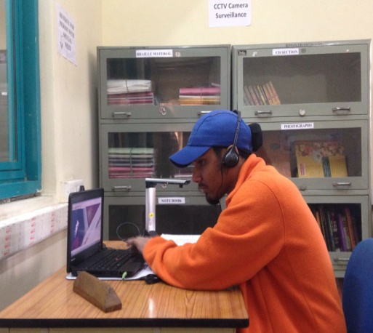
FACILITIES PROVIDED TO USERS WITH SPECIAL NEED
Keshav Mahavidyalaya Library has Audio CDs and braille Materials for visually challenged users.
The Library has one Lez Air Camera Scanner along with a laptop with Lex Air VAD software as well as braille face and Devnagri Software.
Library-Staff locate books, periodicals and other materials for physically challenged users on demand basis.

Slide 20
LIBRARY IS A HUB OF VARIOUS ACTIVITIES
Library is the hub of various college activities. By providing furniture or Reading Room etc. for evaluation work, NSS Events, Internship Fair oF Psychology Department, etc.
Library plays its vital role in the growth of the institution.
Even student union elections were held in the Library.

Slide 21
SERVICES PROVIDED DURING COVID -19 PERIOD
During COVID-19 Period Various services are provided online to users.
A separate e-mail id library @keshav.du.ac.in was created through which I personally solve various queries of students and get them updated with library activities /information.
N-List (a Database of e-Books, e-Journals and other e resources) was purchased by the library during COVID-19 period .

Slide 22
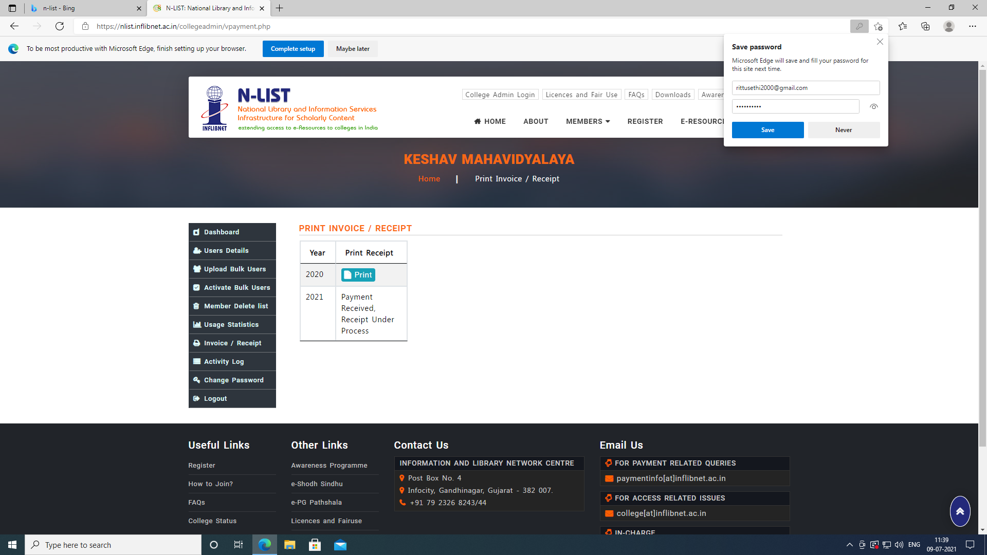
N - LIST

Slide 23
ABOUT N- LIST DATABASE
The Project entitled "National Library and Information Services Infrastructure for Scholarly Content (N-LIST)", being jointly executed by the e-ShodhSindhu Consortium, INFLIBNET Centre and the INDEST-AICTE Consortium, IIT Delhi provides for
cross-subscription to e-resources subscribed by the two Consortia, i.e. subscription to INDEST-AICTE resources for universities and e-ShodhSindhu resources for technical institutions; and
access to selected e-resources to colleges. The N-LIST project provides access to e-resources to students, researchers and faculty from colleges. Large number of e-Books, e-journals, Articles etc are available for users through NLIST.

Slide 24
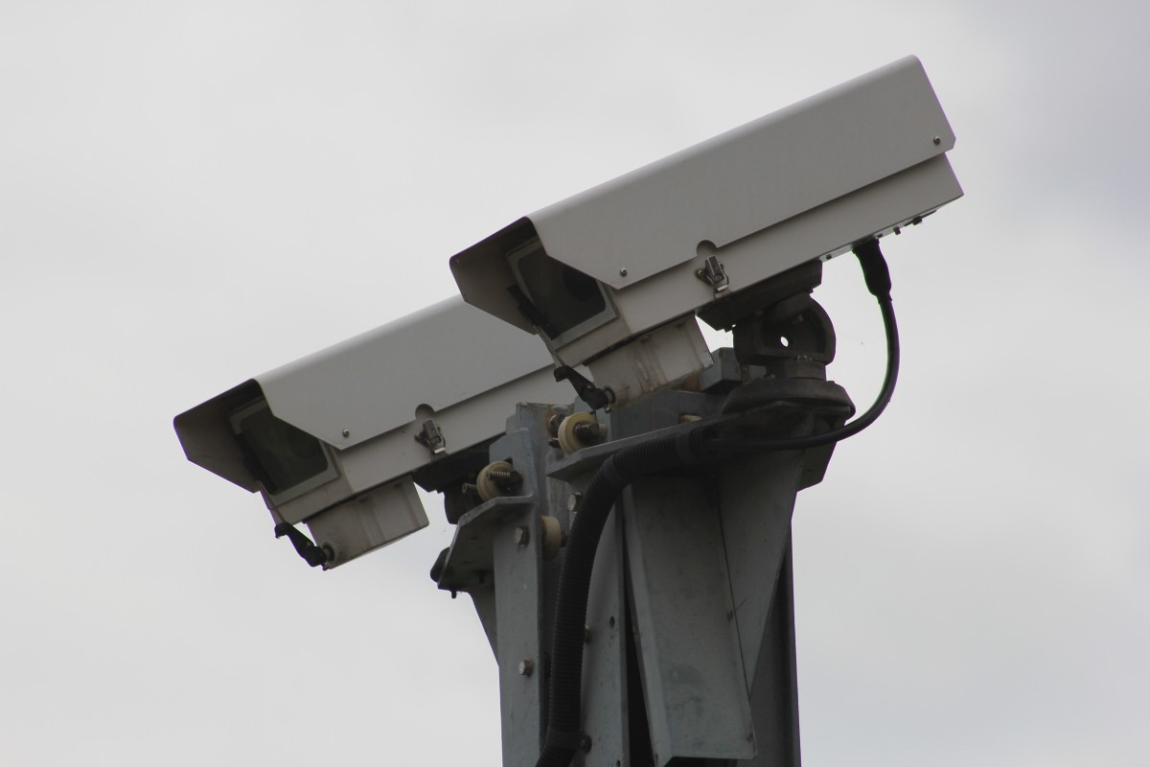
CCTV CAMERA’S
For the security of the library, we have purchased 16 CCTV Camera’s for the college library. The Authority’s cooperation in this regard is really appreciating.

Slide 25
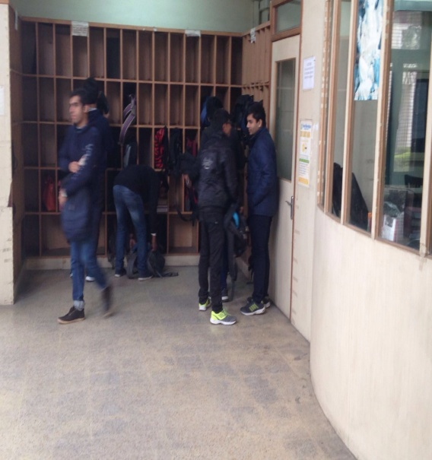
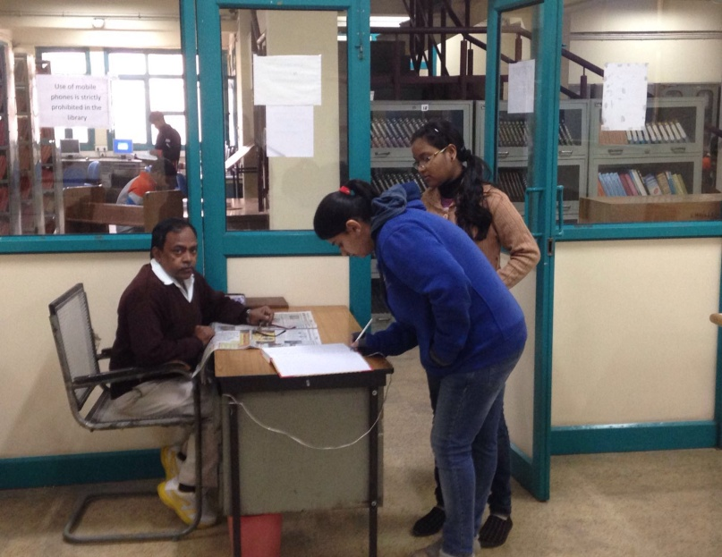
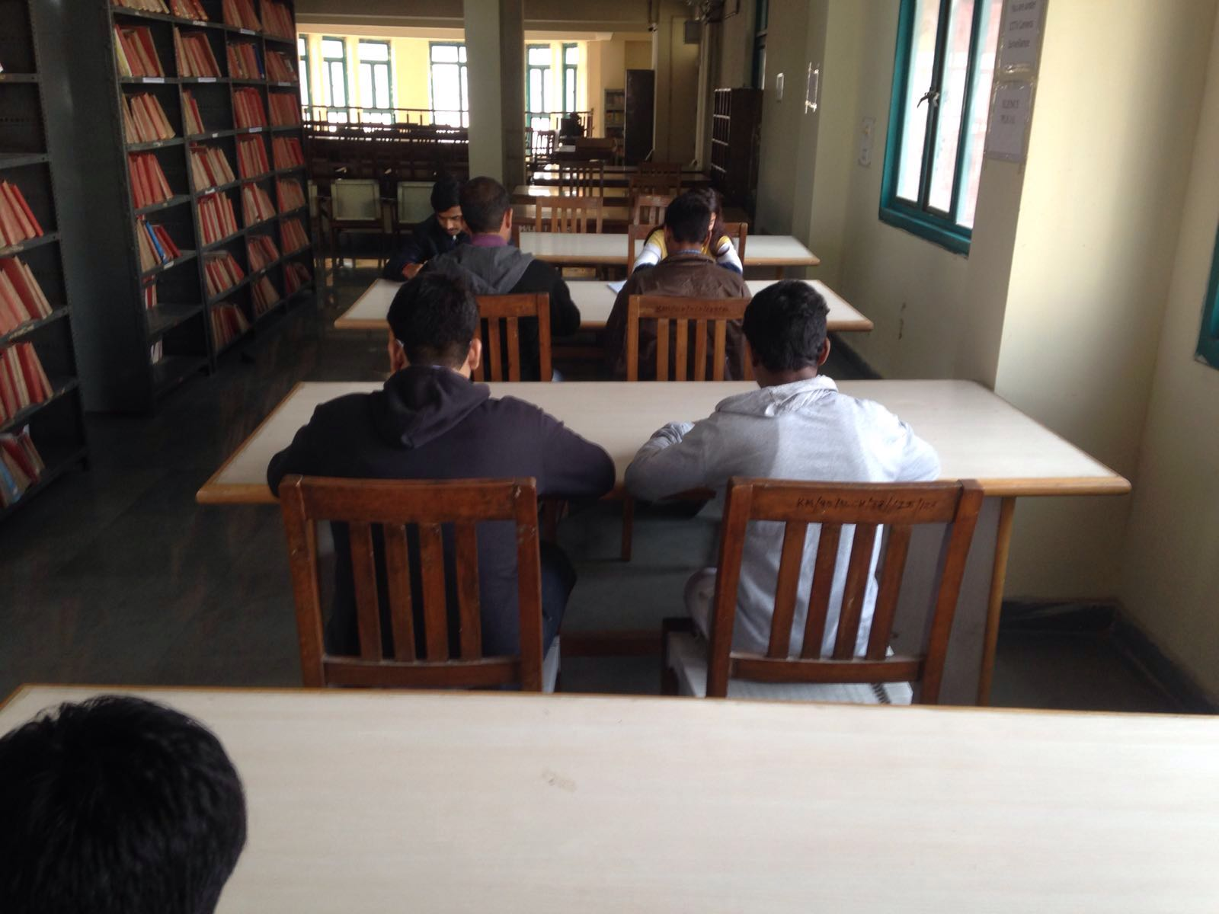
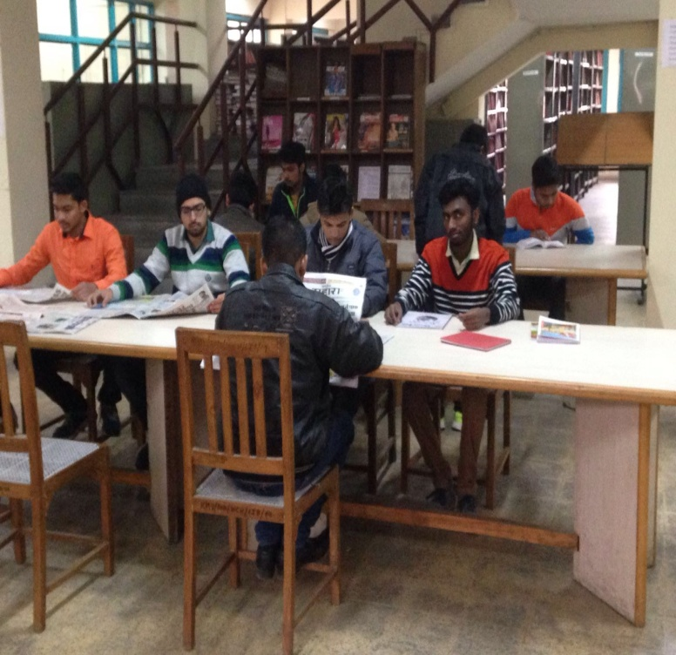
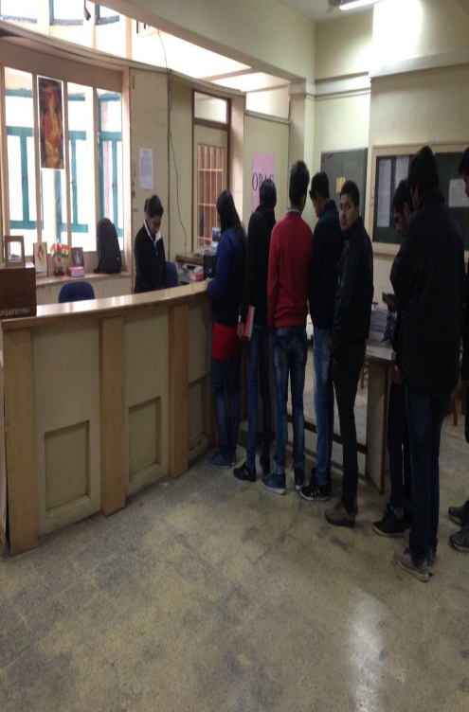
View of library :Various Sections

Slide 26
Library works as a team. The motive of library is to serve at its best and satisfy each and every user.
Latest and Modern Services are being provided by the library.

Slide 27
IMPORTANT LINKS
•IMPORTANT LINKS:-
e Resources provided by D.U (http://crl.du.ac.in/sub.database/ SUBS.E-RESOURCE.htm )
A-Z List of E-journals http://crl.du.ac.in/atozn/
J-GATE@ e-Shodh Sindhu https://jgateplus.com/home/
Scopus http://www.scopus.com/
Web of Science http://www.isiknowledge.com/
E-Books
World e-Book Library http://Community.WorldLibrary.In/?AffiliateKey=NDL-IJ1004
National Digital Library Of India https://ndl.iitkgp.ac.in/
LINK FOR e-GRANTHALAYA http://eg4.nic.in
OPAC LINK OF KESHAV MAHAVIDYALYA LIBRARY http://eg4.nic.in/DELHIGOV/OPAC/Default.aspx?LIB_CODE=KMVLIB

Slide 28
ENTRANCE OF LIBRARY

Slide 29
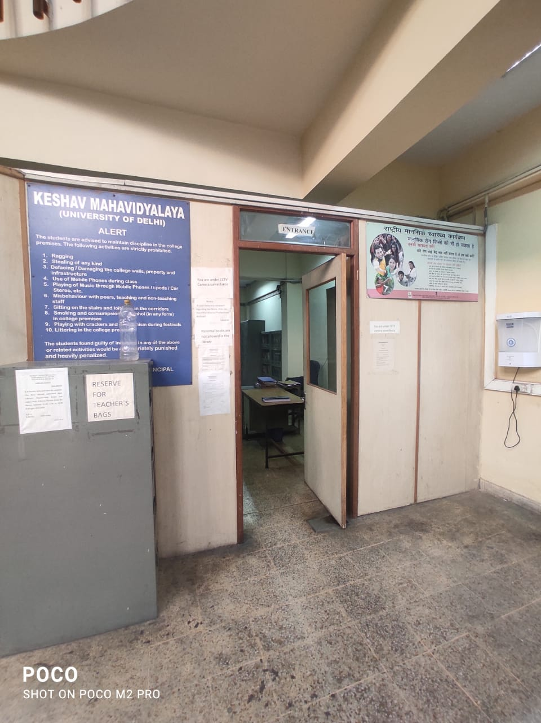
ENTRY DOOR NEAR LIBRARY COUNTER

Slide 30
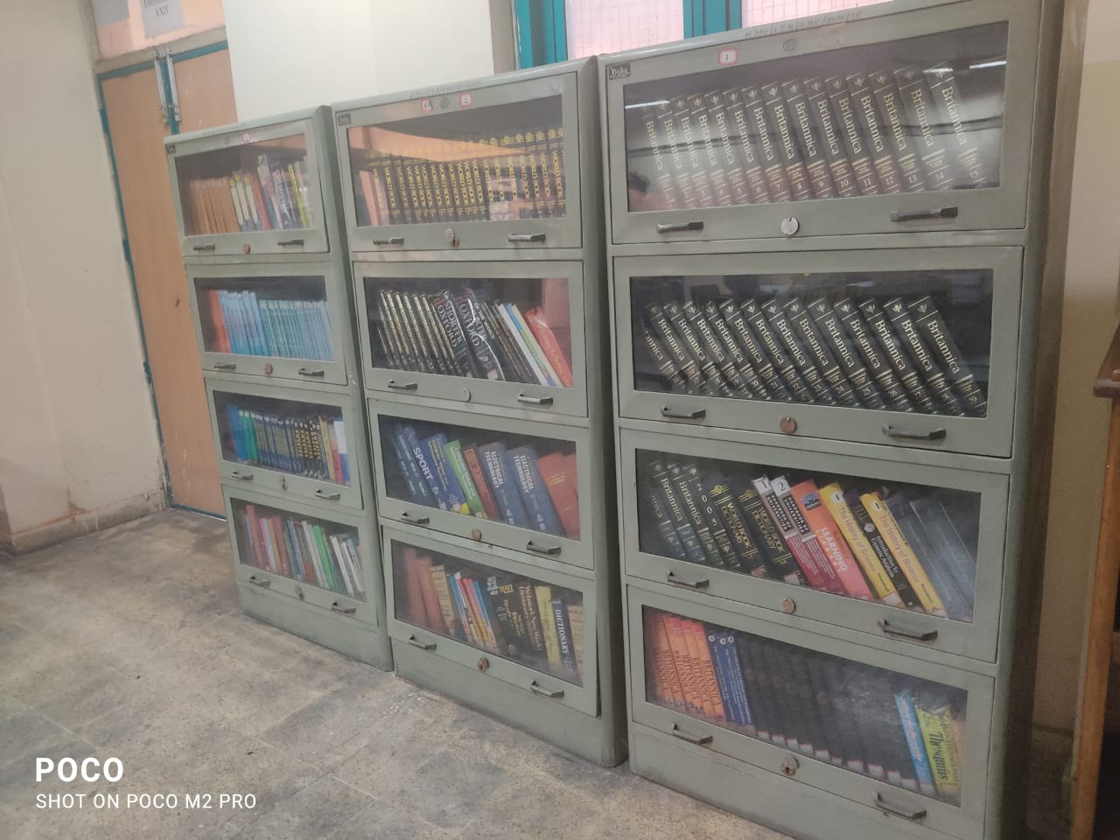
REFERENCE –TOOLS : LIBRARY

Slide 31
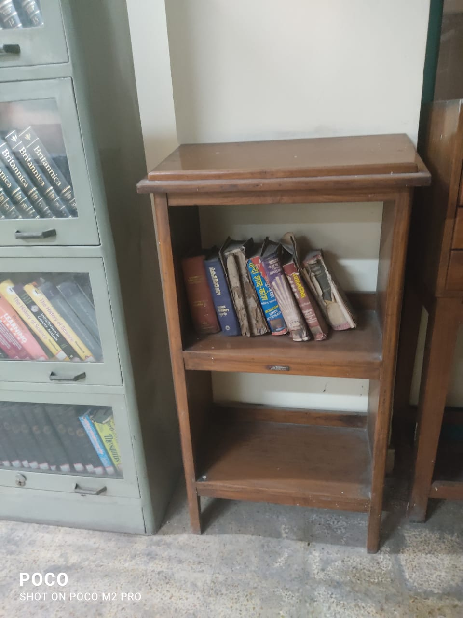
DICTIONARY STAND : LIBRARY

Slide 32
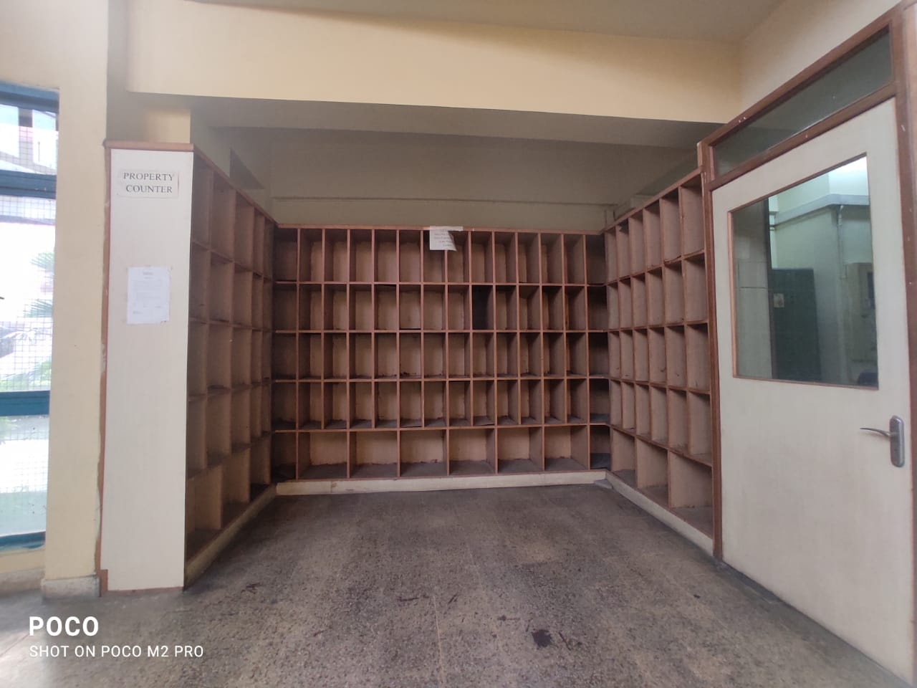
PROPERTY COUNTER: LIBRARY

Slide 33
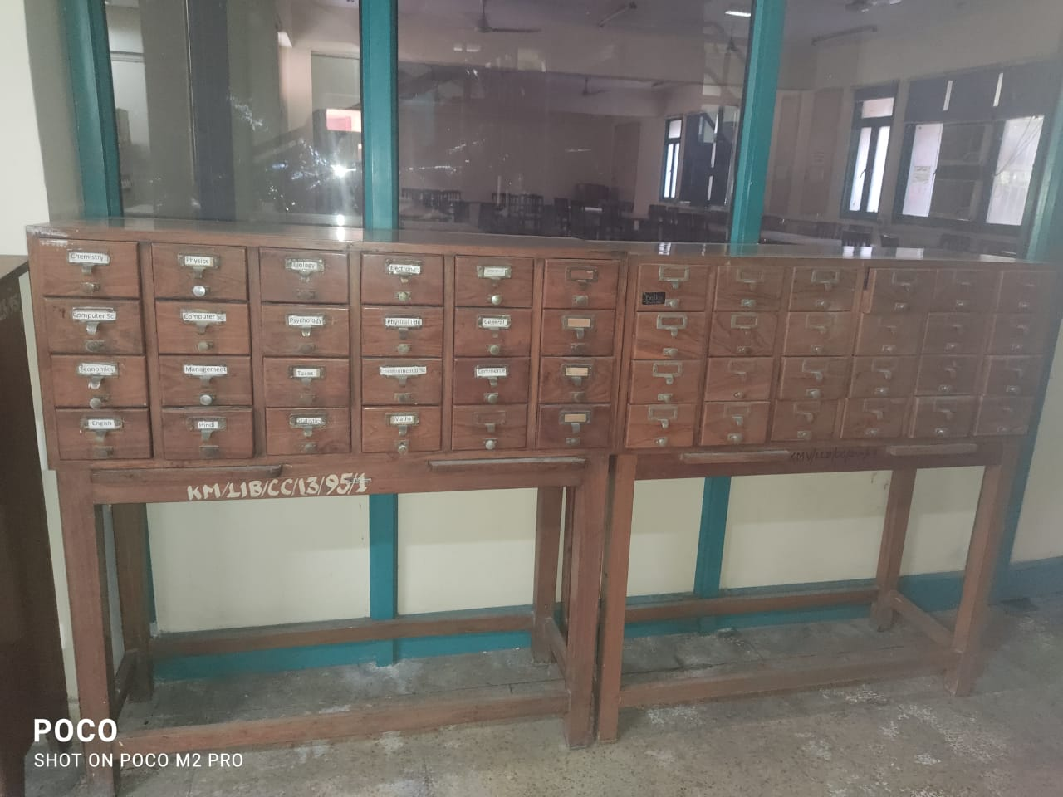
CATALOGUE -CABINETS

Slide 34
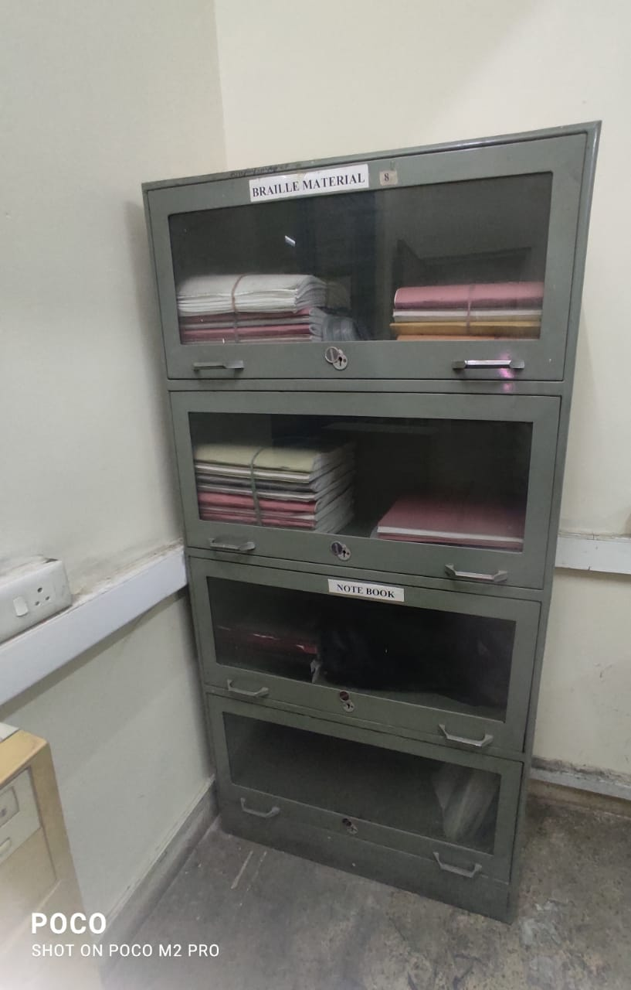
BRAILLE MATERIAL

Slide 35
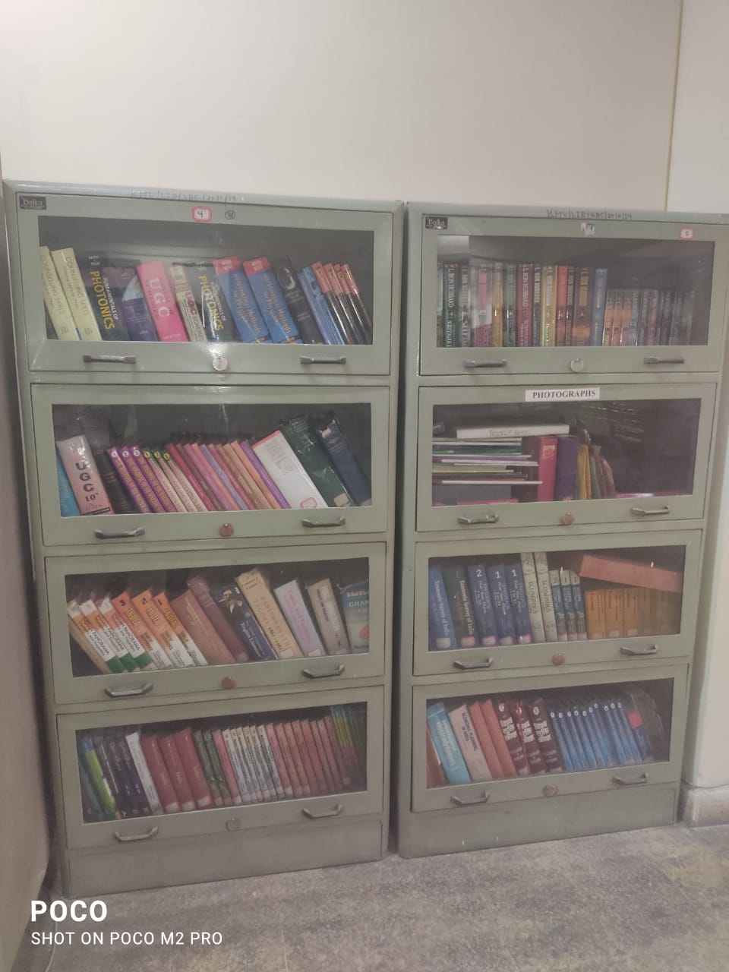
REFERENCE BOOKS

Slide 36
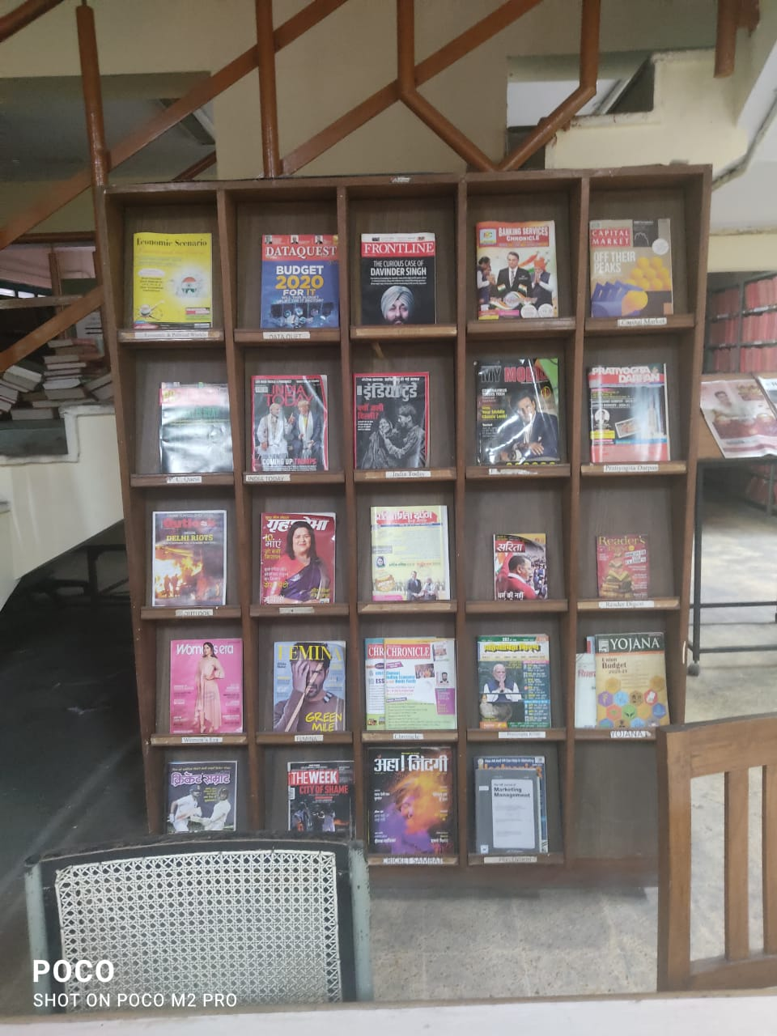
PERIODICAL RACK

Slide 37
LIBRARY - COUNTER

Slide 38
PERIODICAL SECTION

Slide 39
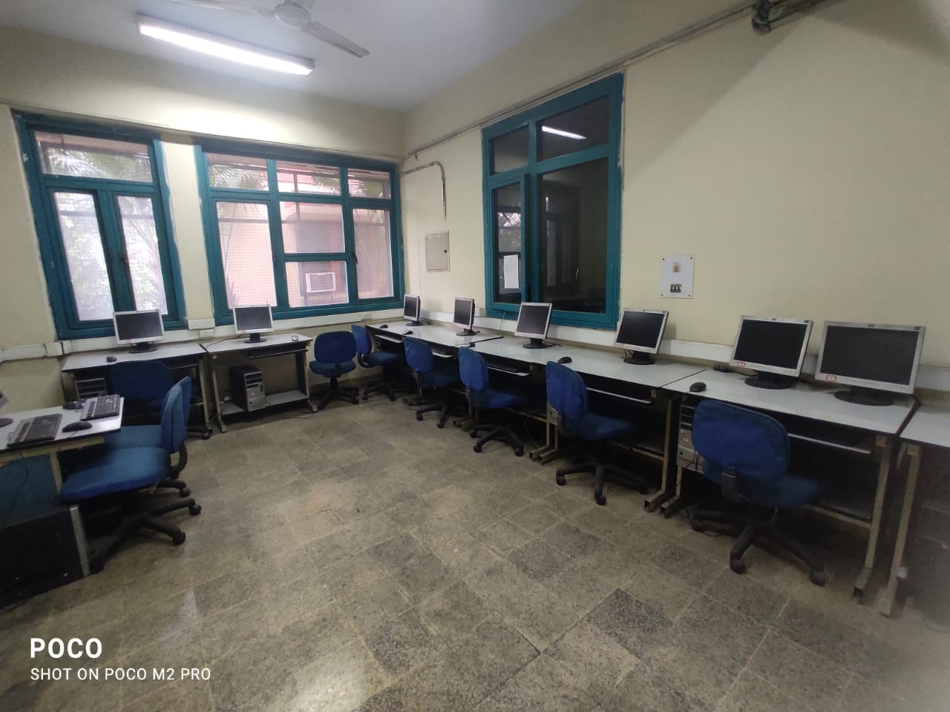
INTERNET LAB: LIBRARY

Slide 40
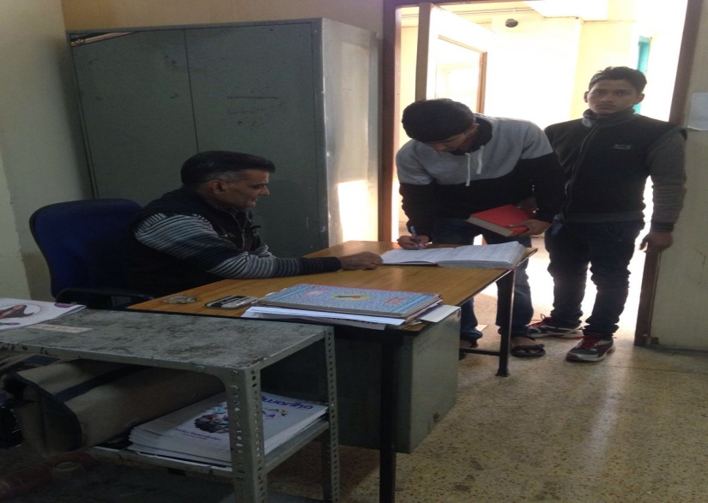
ENTRY IN REGISTER

Slide 41
READING -ROOM ENTRANCE

Slide 42
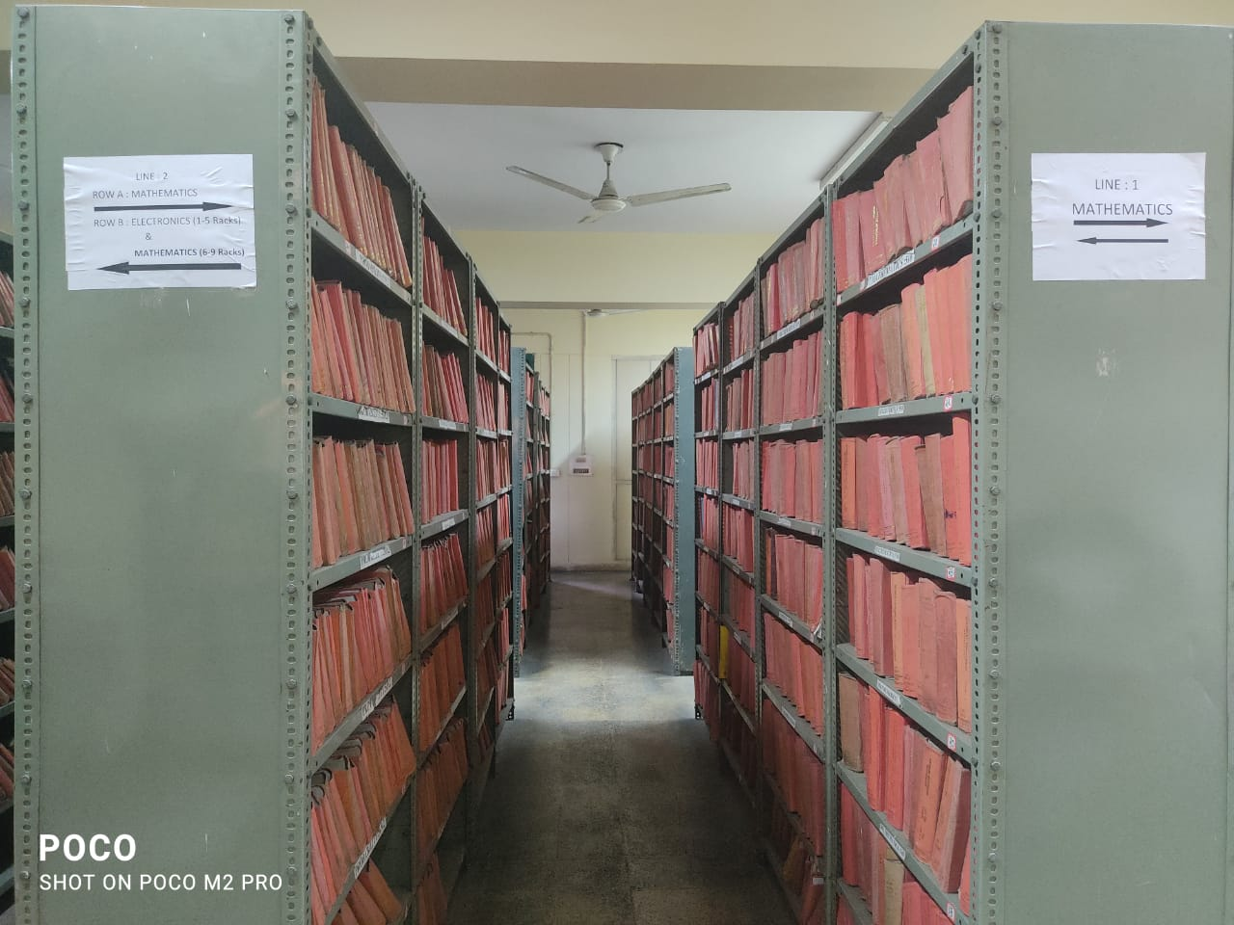
LINE 1 : MATHEMATICS LINE 2: SIDE A: MATHEMATICS SIDE B : ELECTRONICS(1-5 RACKS) MATHEMATICS (6-9 RACKS)

Slide 43
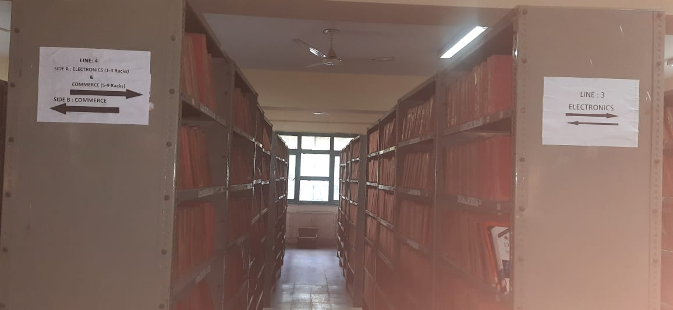
LINE: 3 : ELECTRONICS LINE 4 : SIDE A : ELECTRONICS (1-4 RACKS) COMMERCE (5-9 RACKS) SIDE B : COMMERCE

Slide 44
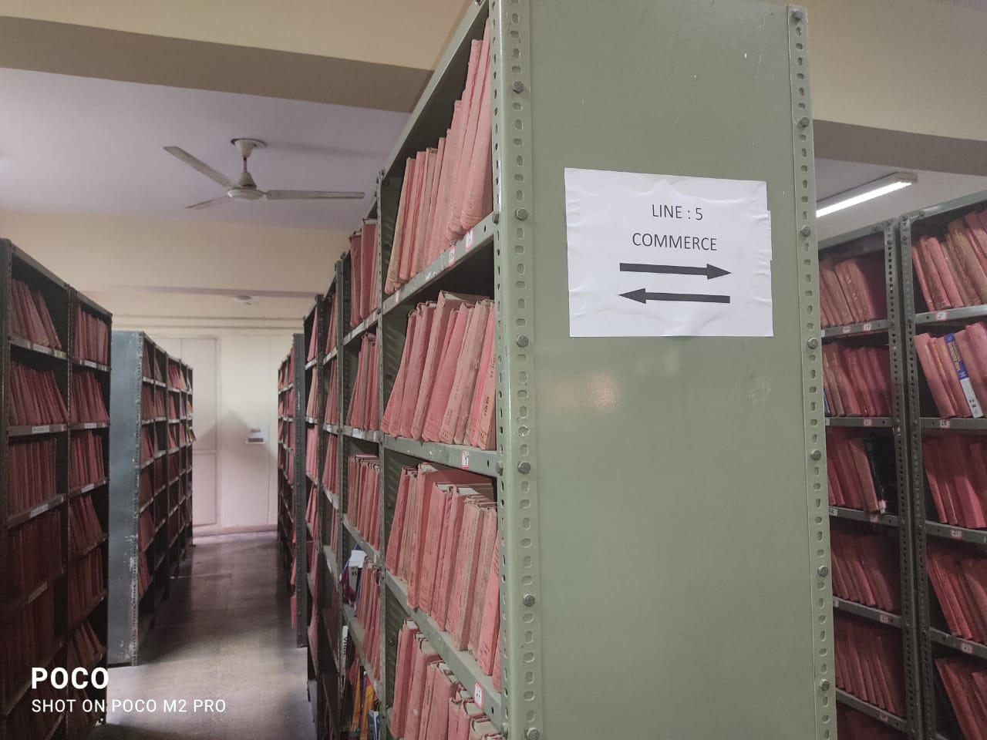
LINE : 5 : COMMERCE

Slide 45
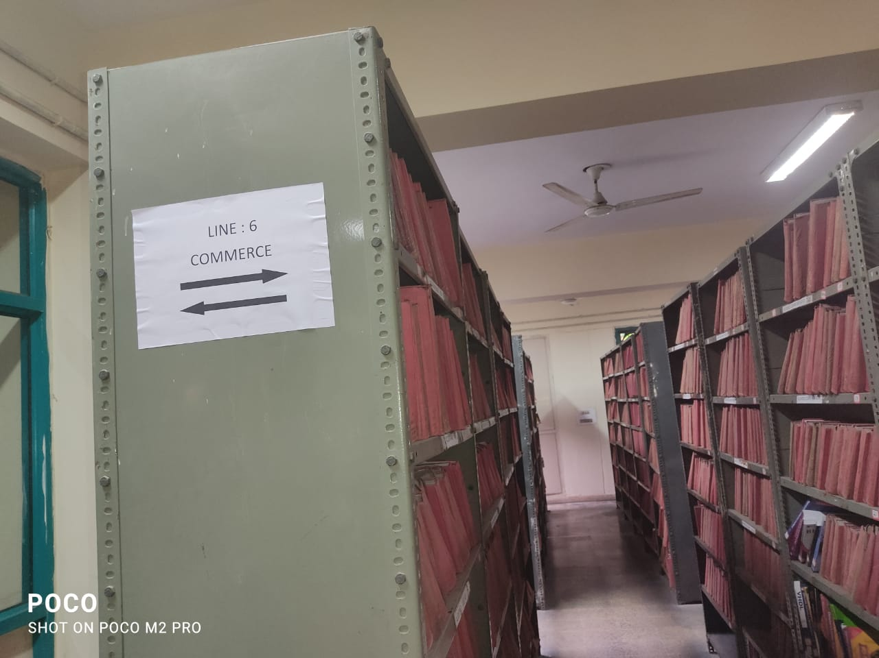
LINE 6 : COMMERCE

Slide 46
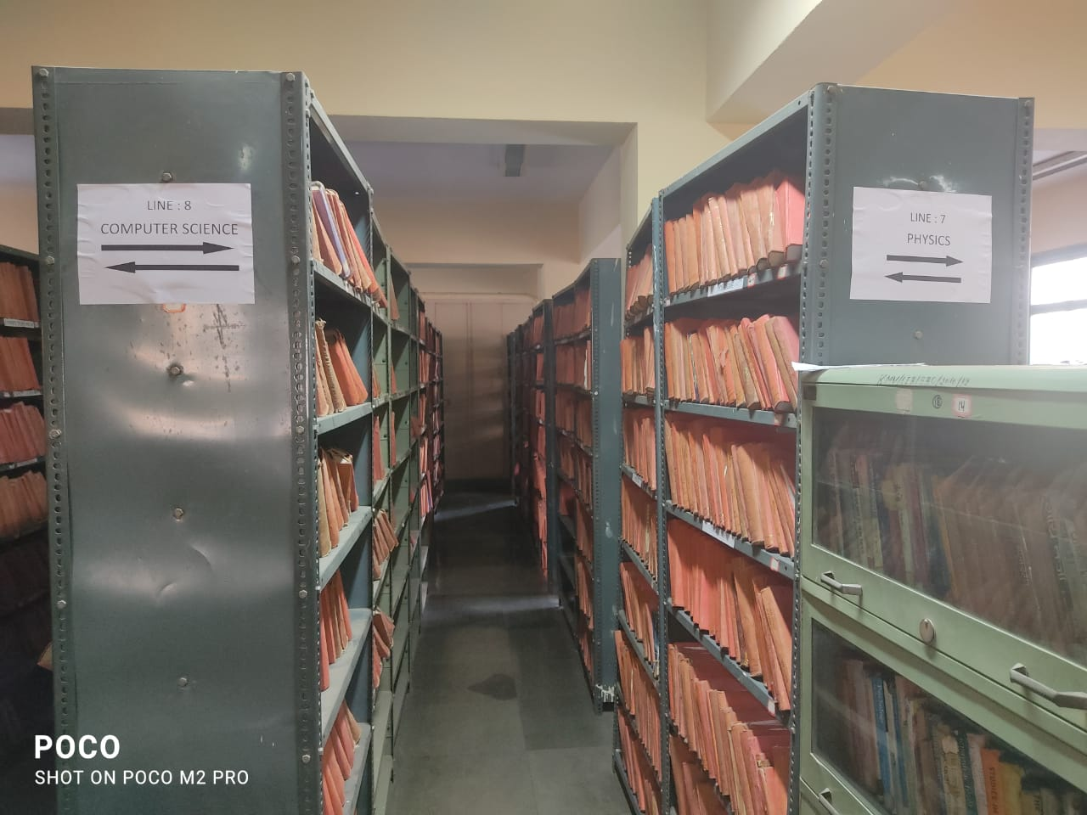
LINE : 7 PHYSICS

Slide 47
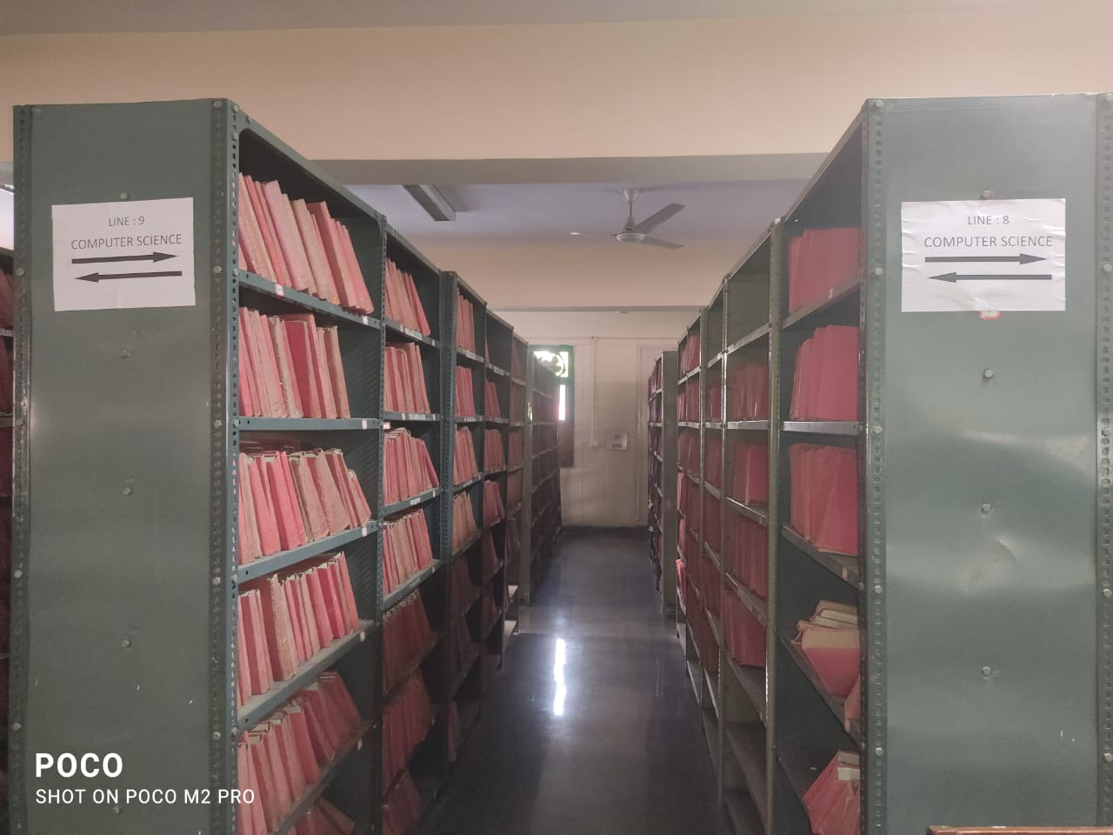
COMPUTER SCIENCE LINE NO.8 &9 (FIRST FLOOR)

Slide 48
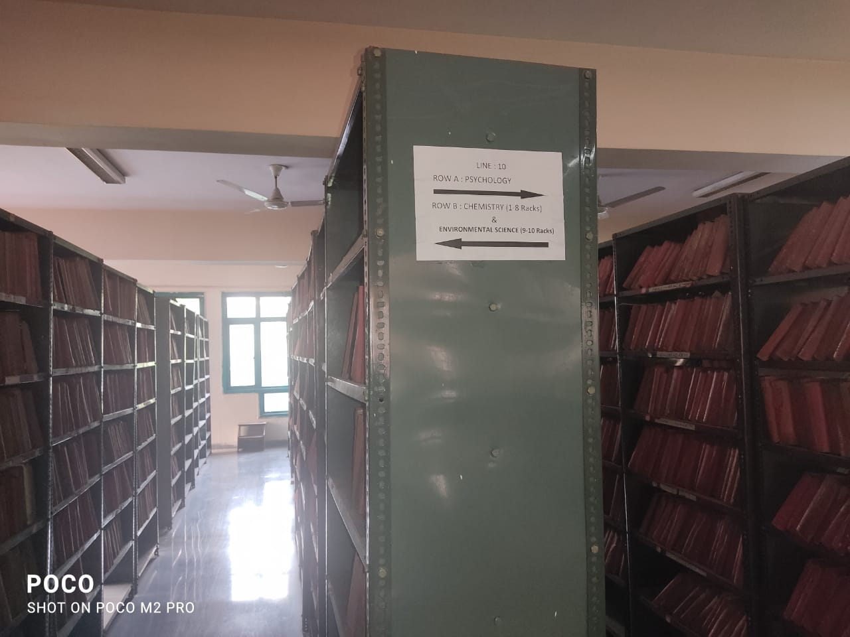
LINE 10 : ROW A: PSYCHOLOGY ROW B :CHEMISTRY (1-8 RACKS) ENVIRONMENTAL SC. (9-10 RACKS)

Slide 49
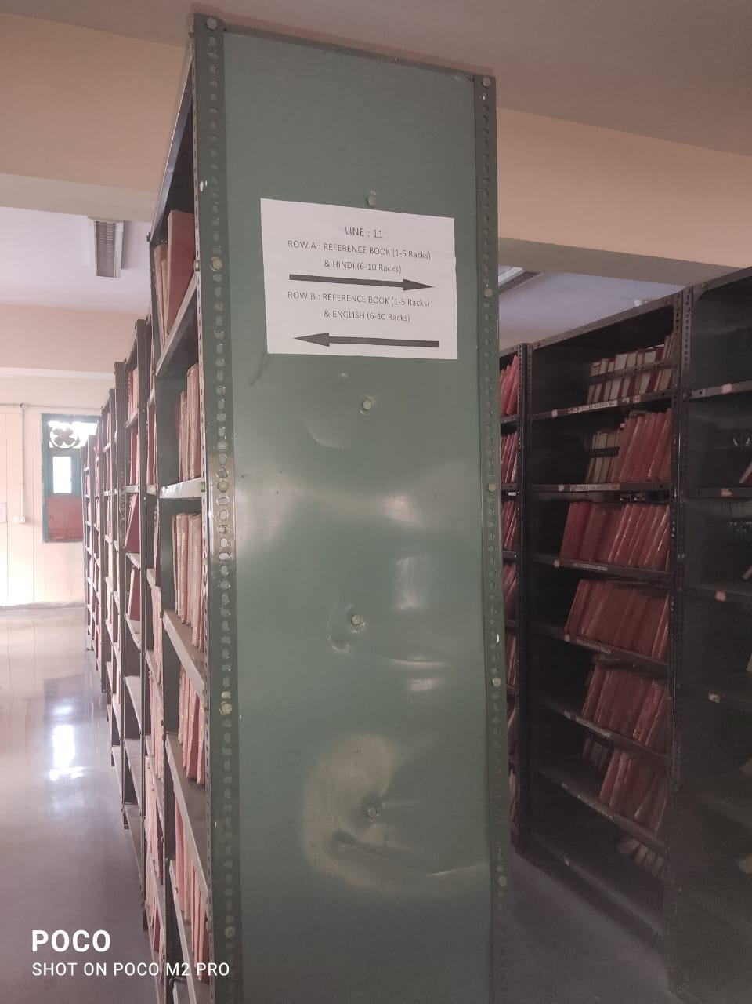
LINE:11 ROW A: REFERENCE BOOKS(1-5 RACKS) & HINDI (6-10 RACKS) ROW B: REFERENCE BOOK (1-5 RACKS) & ENGLISH (6-10 RACKS)

Slide 50
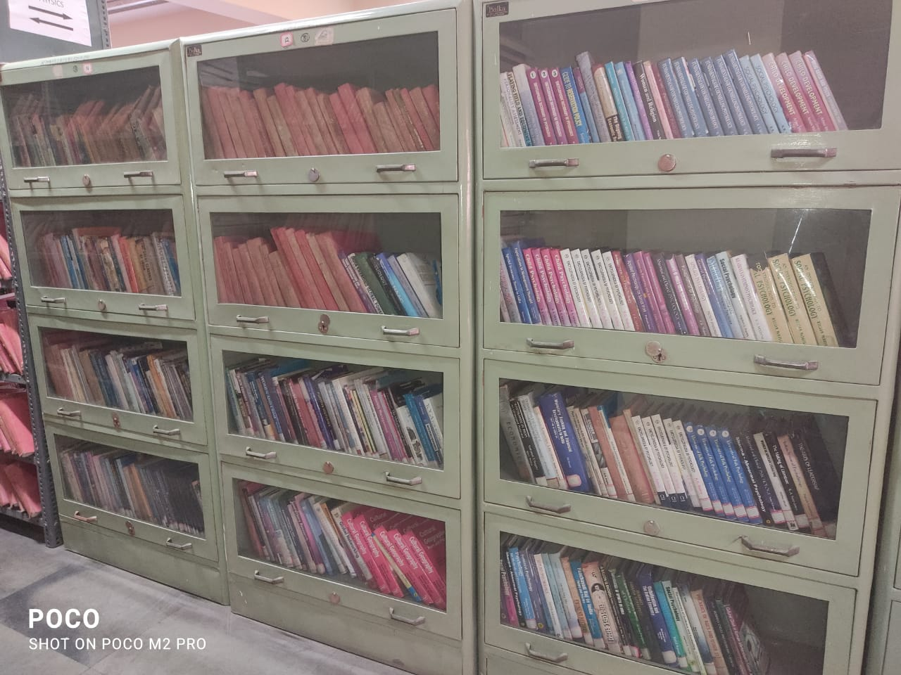
BOOK CASES: FIRST FLOOR

Slide 51
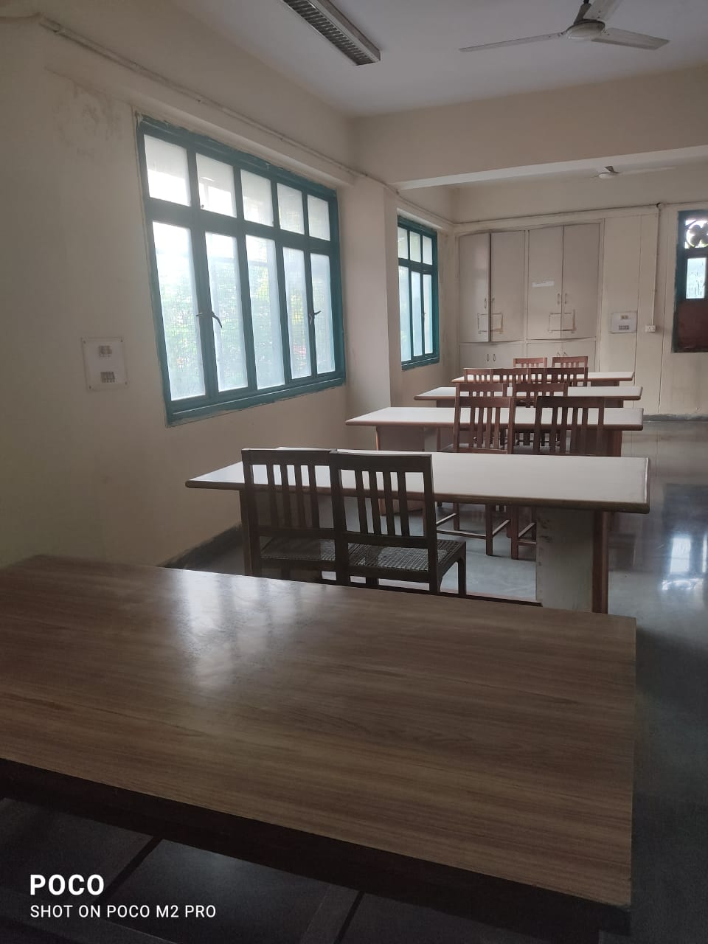
FIRST FLOOR READING SPACE FOR STUDENTS.

Slide 52
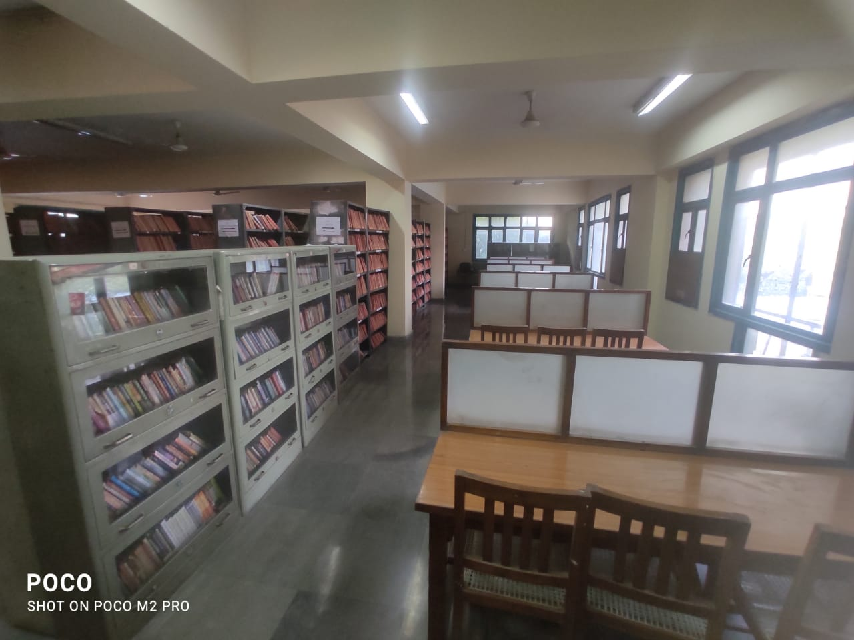
FACULTY’S READING SPACE ON FIRST FLOOR

Slide 53
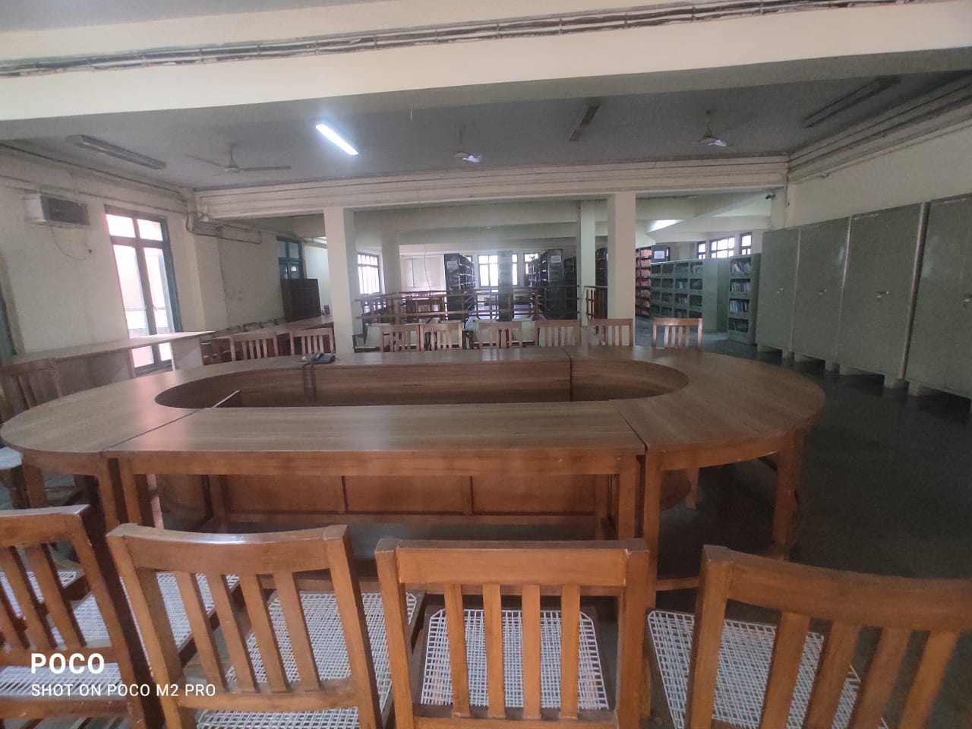
SEMINAR TABLE ON FIRST FLOOR

Slide 54
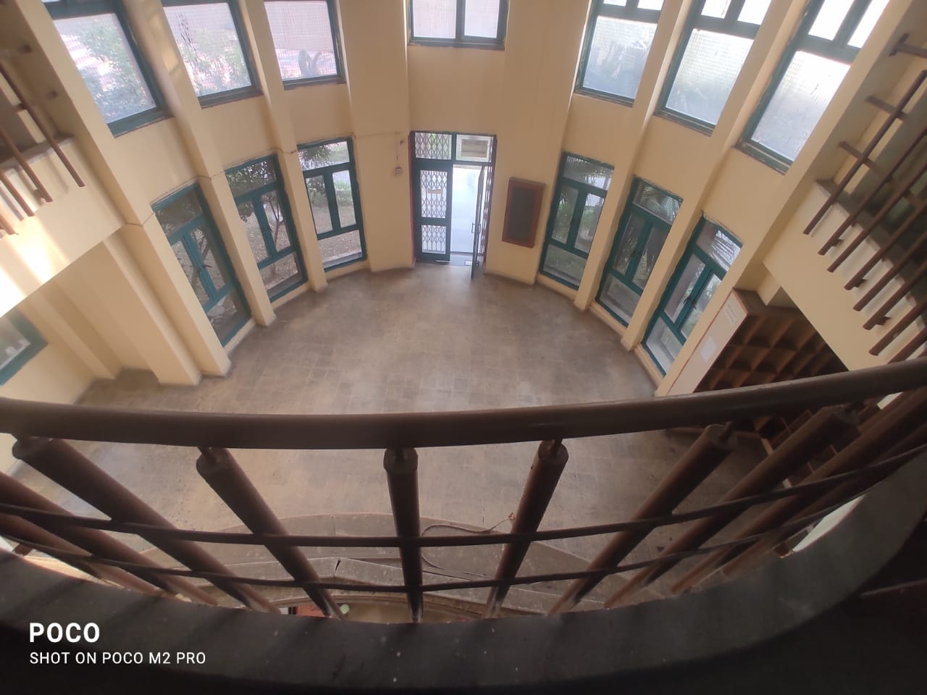
LIBRARY VIEW FROM FIRST FLOOR: PROPER SUN LIGHT.

Slide 55
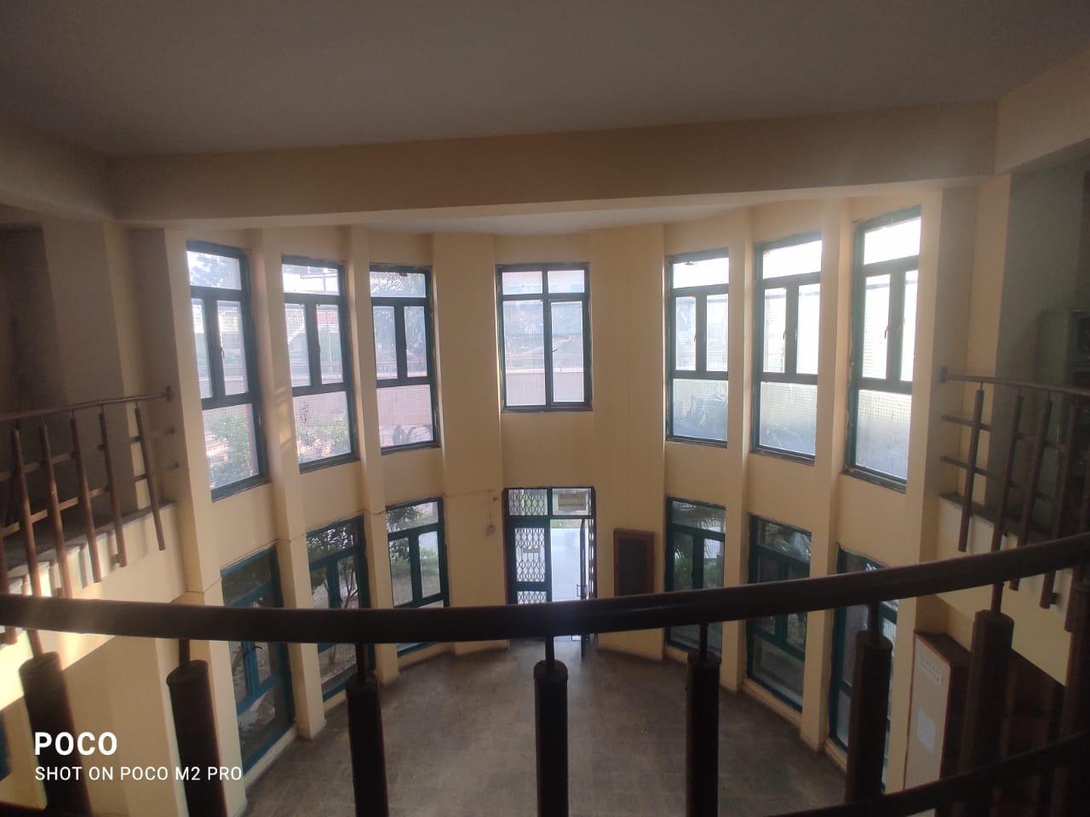
LIBRARY VIEW FROM FIRST FLOOR: PROPER SUN LIGHT.

Slide 56
Enjoy Learning
Library is a temple of Learning.
THANK-YOU

